Slide 1
Evolution of Populations
Genetic variability in populations
Calculating allele frequencies
The Hardy-Weinberg principle
Forces that alter allele frequencies
Details of natural selection
Reading: Chapter 23: all
Suggested problems: 1-5

Slide 2
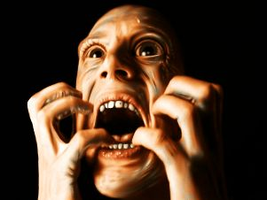
Evolution of Populations
(applying ideas of evolution to real world)
Remember:
Natural selection acts on individuals, and as a result, populations evolve over time
For populations to evolve (change) over time, individuals in the population must exhibit variability
Mutation is the ultimate source of new alleles
in a population, but meiosis and sex generate
variability in population by creating unique
combinations of alleles.
Oh no….meiosis is back!

Slide 3
Genetic Structure of a Population
SPECIES
-a group of individuals who can breed & produce viable, fertile offspring
POPULATION
-localized group of individuals of the same sp.
-may be isolated from other pops. of the same sp.
GENE POOL
-all the alleles in a pop. at any time
-remember for diploids, you have 2 copies of every gene
-for multiple alleles, each has a relative frequency in the population

Slide 4
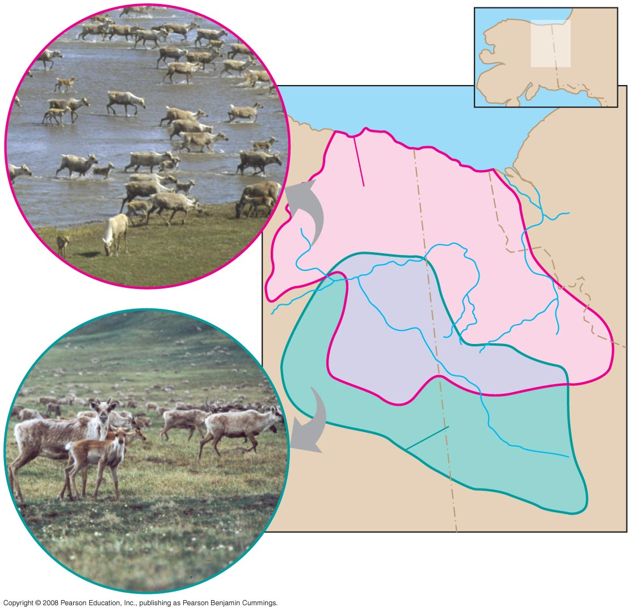
What is a population?
Porcupine herd
MAP
AREA
Fig. 23-5
CANADA
ALASKA
Beaufort Sea
NORTHWEST
TERRITORIES
Porcupine
herd range
Fortymile
herd range
YUKON
ALASKA
Fortymile herd
Two populations of caribou

Slide 5
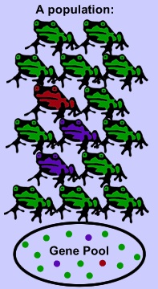
Determining Whether or Not a Population is Evolving: quantifying changes in genetic variability
A population’s genetic make-up is typically described by measuring allele frequencies in its gene pool
Gene pool:

Slide 6
Determining allele frequency (the proportion of an allele for a specific gene in a population)
Frequency of an allele: # of copies of an allele
# of copies of all alleles at the locus
For a locus with 2 alleles:
p= frequency of one allele
q= frequency of the other allele

Slide 7
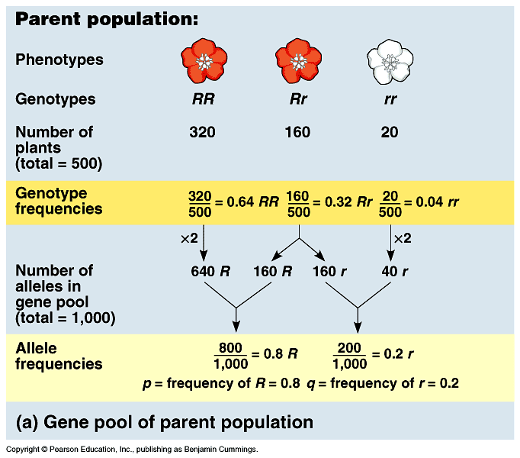
ONLY 2 ALLELES
CALCULATING ALLELE FREQUENCIES
GENETIC STRUCTURE

Slide 8
Populations that are NOT evolving are in Hardy-Weinberg equilibrium
Hardy-Weinberg Principle:
The frequencies of alleles and genotypes in a population will remain constant from generation to generation in the absence of any disturbing forces

Slide 9
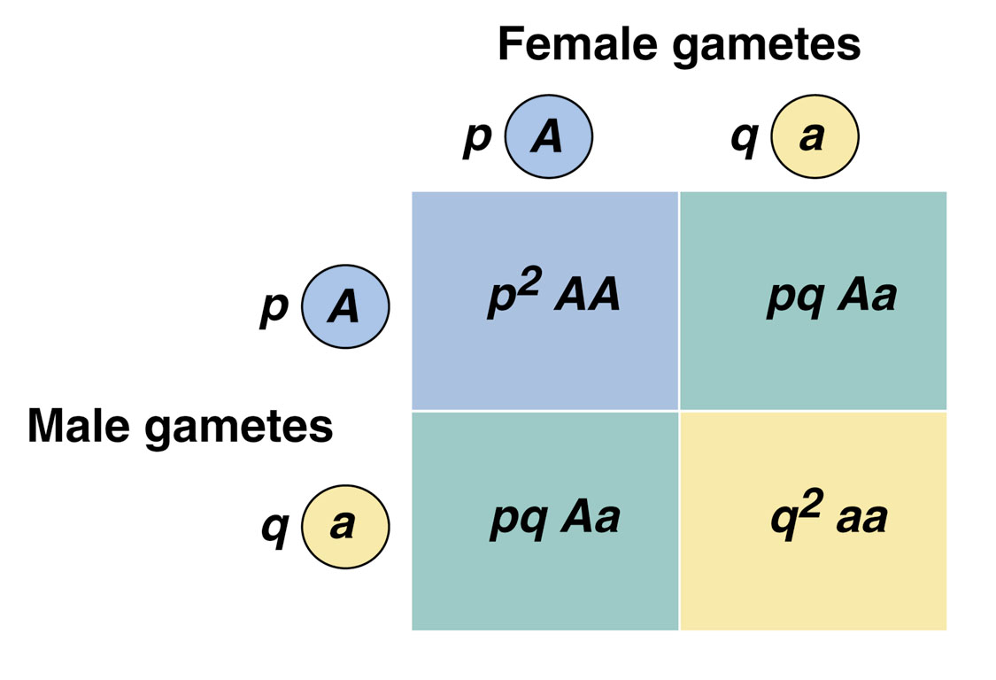
Hardy-Weinberg Equation: p² (AA) + 2pq (Aa) + q² (aa)=1
Note: The sum of the genotypic frequencies will always total 1, even if the population is not in Hardy-Weinberg equilibrium

Slide 10
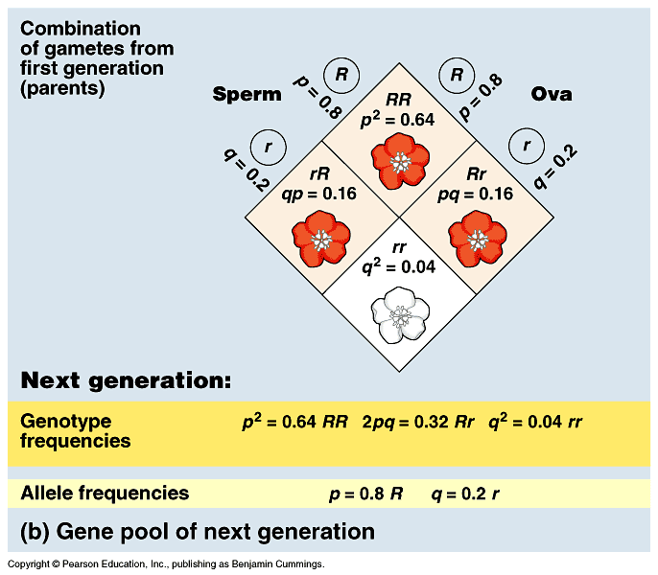
p = freq. of one allele
q = freq. of one allele
equilibrium
p = freq. of R
q = freq. of r

Slide 11
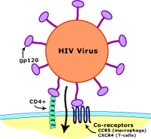
The CCR5 gene as a case study in population genetics
CCR5 is a chemokine receptor located on the surface of some white blood cells
HIV can use the CCR5 receptor on CD4+ cells during infection
T-cell
CCR5

Slide 12
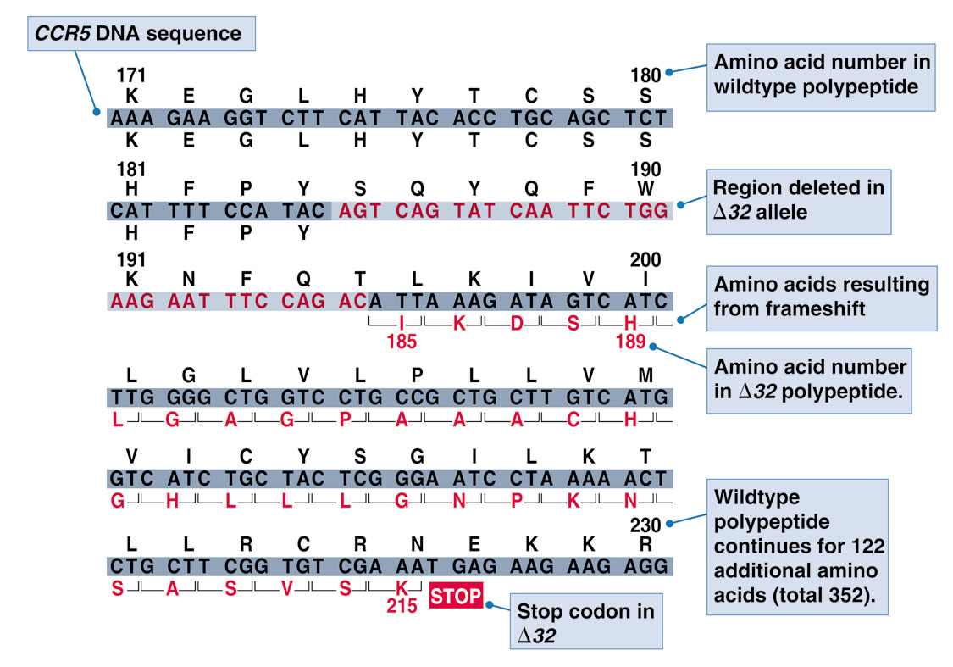
40% of AIDS “non-progressors” are heterozygous for a deletion in CCR5

Slide 13
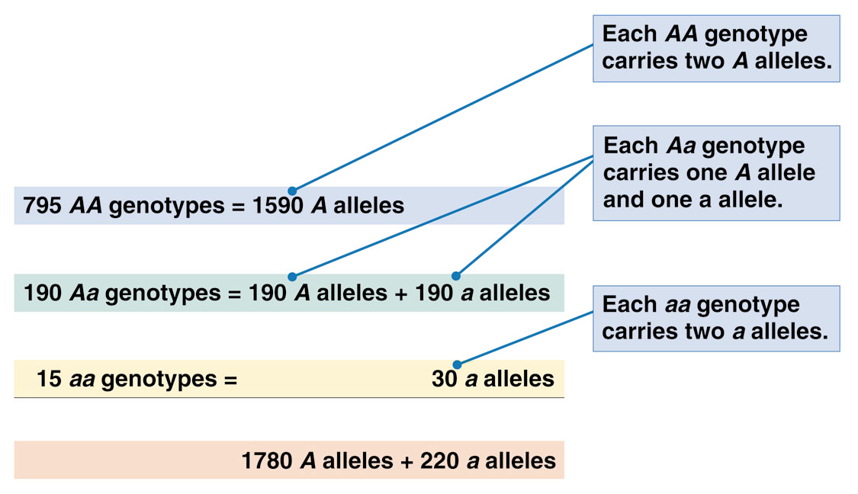
CCR5 study results for a population of 1000 French people
normal CCR5 allele=A
Δ32 allele= a
Total number of alleles
Frequency of an allele: # of copies of an allele
# of copies of all alleles at the locus
Allele frequency of A= 1780/2000=0.89
Allele frequency of a= 220/ 2000=0.11
Total=1

Slide 14
The Hardy-Weinberg equation can also be used to determine the percentage of carriers of recessive disease alleles in a population
Ex:
Torsion dystonia is a movement disorder that affects 1 in 1000 Jewish people of Eastern European descent. What is the carrier frequency in this population?

Slide 15
Testing Whether a Population is Evolving
For a locus with 2 alleles (A and a), in a population at risk from an infectious
neurodegenerative disease:
16 people had gentotype AA
92 had genotype Aa
12 had genotype aa.
Does this population appear to be evolving?
1st determine allele frequencies.
2nd determine what expected frequencies would be for population
that is not evolving.
3rd determine whether actual frequencies match HW frequencies.

Slide 16
Conditions for Hardy-Weinberg equilibrium (the absence of disturbing forces)
No mutation – alters gene pool
Random mating – no inbreeding
No natural selection – every individual can reproduce
Extremely large population size – rules out sampling error
No gene flow – no genes moving in and out of population
When at least one of these is NOT met, changes in allele frequency can occur.
MICROEVOLUTION OCCURS

Slide 17
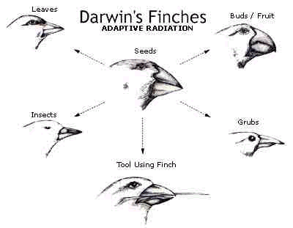
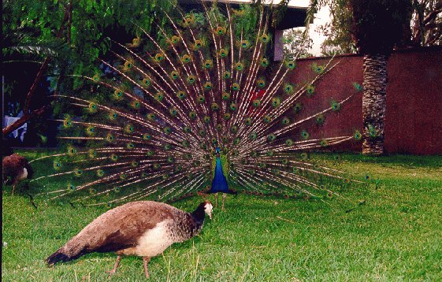
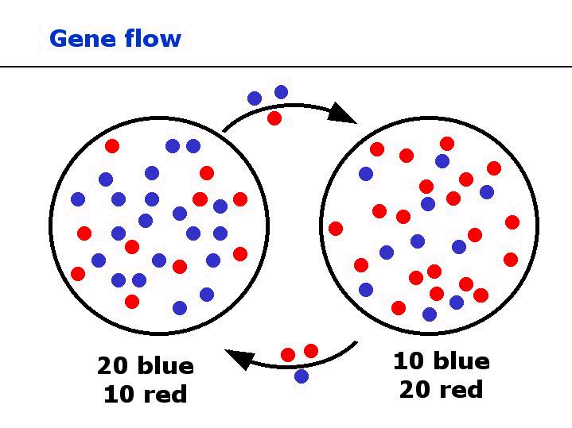
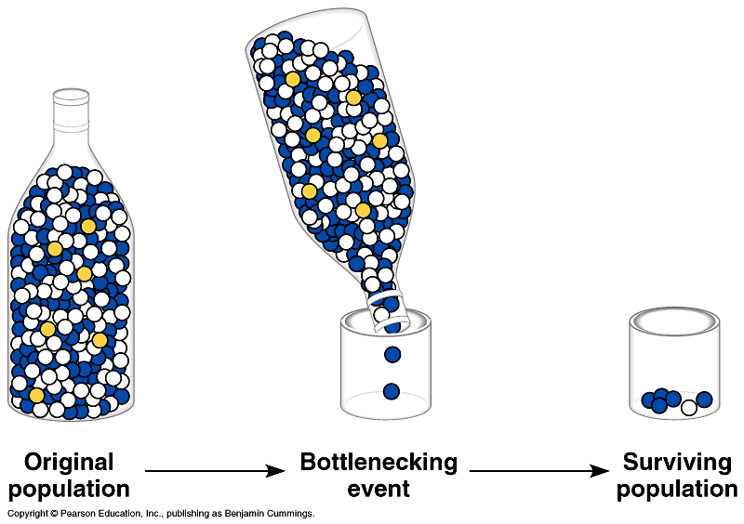
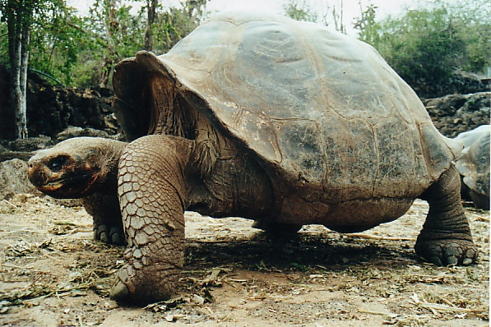
Causes of Microevolution
1) Genetic Drift
-small population
-bottleneck effect
2) Gene Flow
-migrating individuals
3) Genetic Mutations
-only way to get new
alleles
4) Selective Mating
-may lead to sexual dimorphism
5) Natural Selection
-generally adapts a pop to its environment

Slide 18
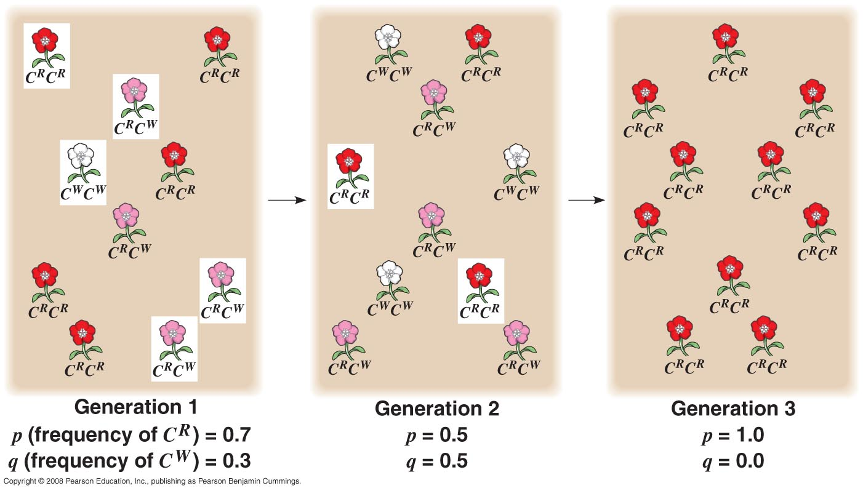
Forces that alter allele frequencies: genetic drift
Genetic drift:

Slide 19
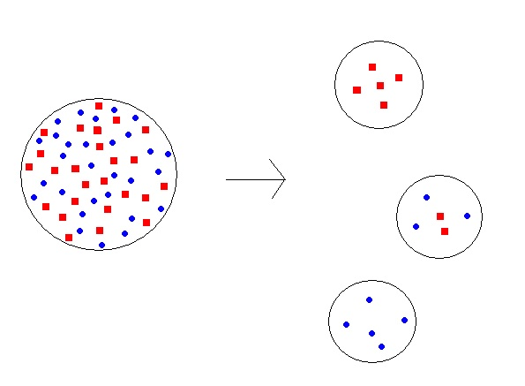
Founder effect is a specific type of genetic drift
Founder effect:

Slide 20
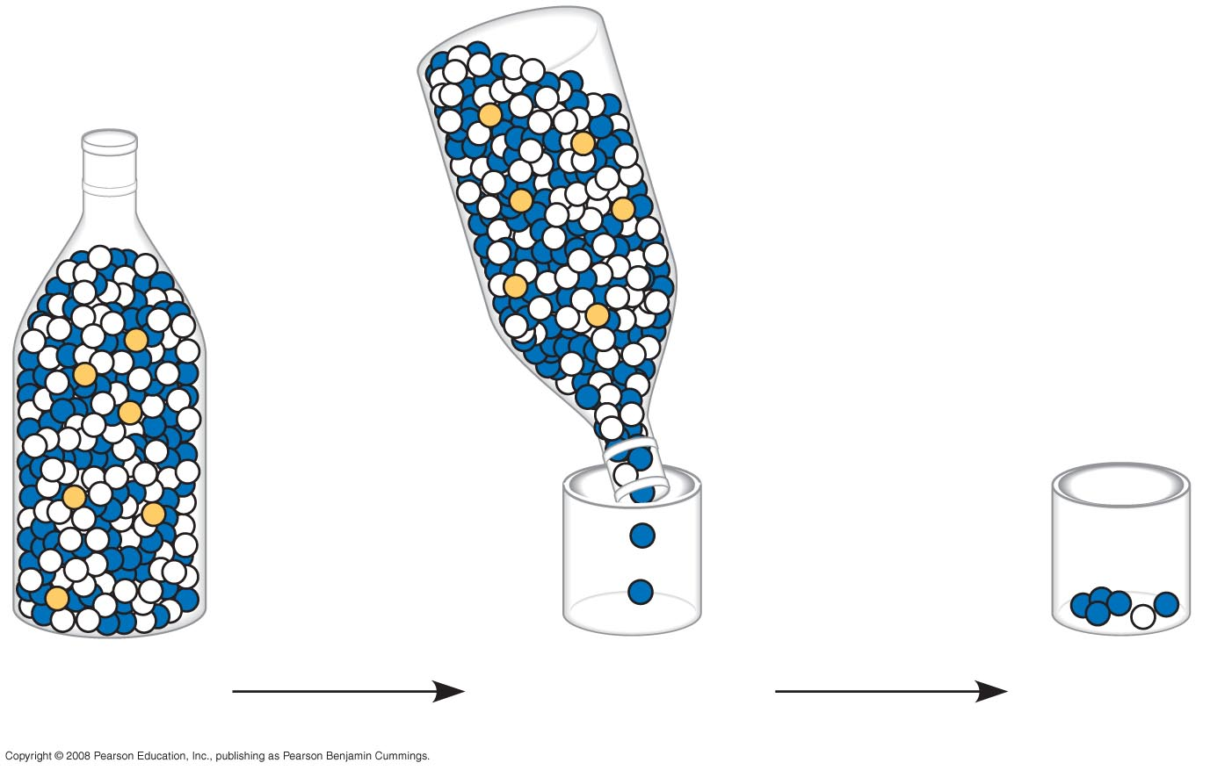
The bottleneck effect is a specific type of genetic drift
Bottleneck effect:
Fig. 23-9
Original
population
Bottlenecking
event
Surviving
population

Slide 21
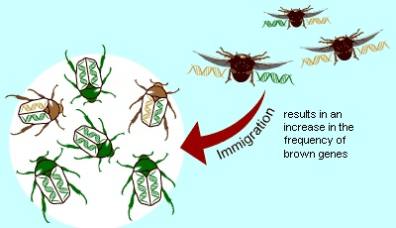
Forces that alter allele frequencies: gene flow
Migration in a hypothetical beetle population w/ 2 coloration alleles

Slide 22
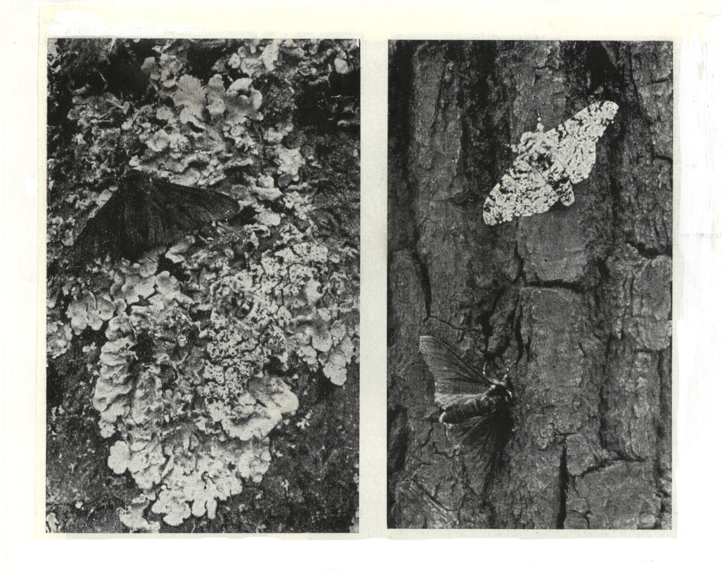
Forces that alter allele frequencies: natural selection
Biston betularia
Fitness &
Relative
Fitness
Notes:
Industrial Melanism
Many species of moths in the British Isles began to become darker in color in the 19th century.The best-studied example is the peppered moth, Biston betularia. The moth gets its name from the scattered dark markings on its wings and body.In 1849, a coal-black mutant was found near Manchester, England. Within a century, this black form had increased to 90% of the population in this region.The moth flies at night and rests by day on tree trunks. In areas far from industrial activity, the trunks of trees are encrusted withlichens. As the photos show, the light form (circled in red) is practically invisible against this background.In areas where air pollution is severe, the combination of toxic gases and soot has killed the lichens and blackened the trunks. Against such a background, the light form stands out sharply.The moth is preyed upon by birds that pluck it from its resting place by day. In polluted woods, the dark form has a much better chance of surviving undetected. When the English geneticist H. B. D. Kettlewell (who supplied the photos) released moths of both types in the woods, he observed that birds did, indeed, eat a much higher fraction of the light moths he released than of the dark.Since pollution abatement programs were put in place after World War II, the light form has been making a comeback in the Liverpool and Manchester areas.

Slide 23
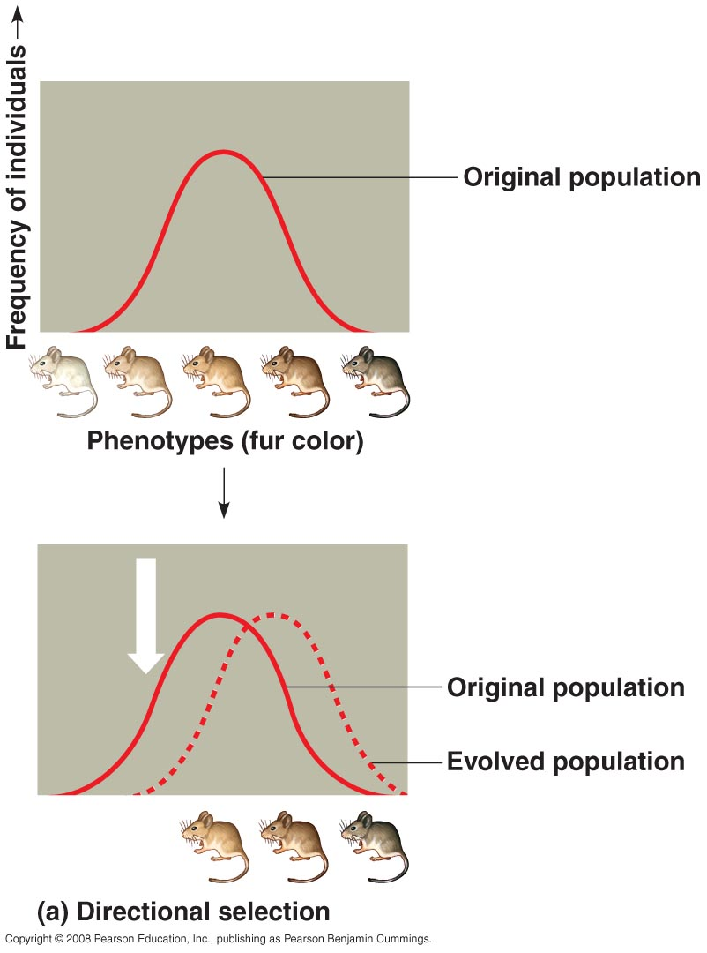
Natural selection can alter the frequency of heritable traits in different ways, depending on the type of selection
1. Directional selection: one extreme of the phenotypic range is favored

Slide 24
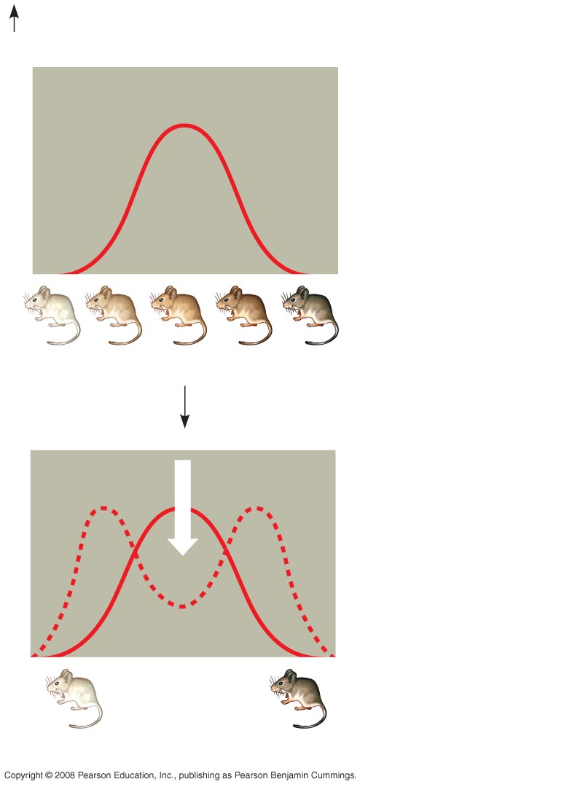
2. Disruptive selection: both extremes of the phenotypic range are favored
Frequency of individuals
Original population
Phenotypes (fur color)
Evolved population
Fig. 23-13b
(b) Disruptive selection

Slide 25
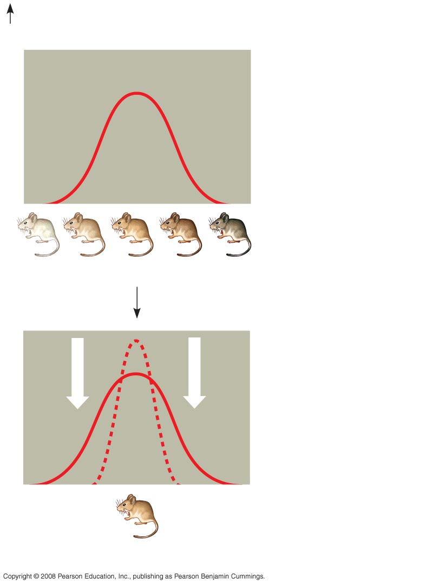
3. Stabilizing selection: favors intermediate phenotypes
Frequency of individuals
Original population
Phenotypes (fur color)
Evolved population
Fig. 23-13c
(c) Stabilizing selection

Slide 26
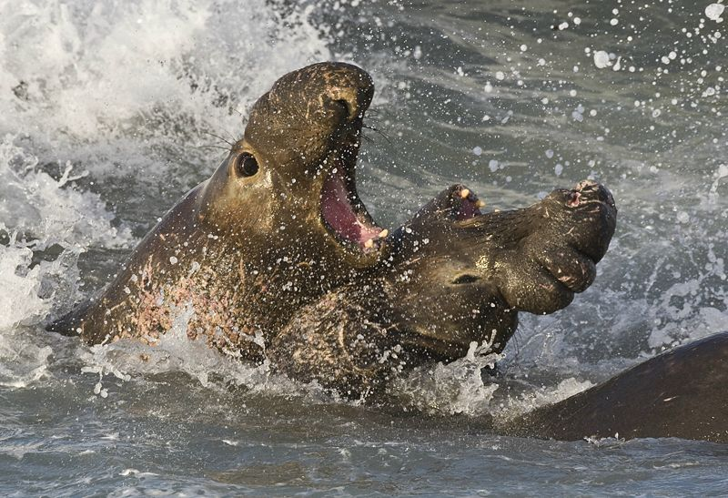
Modes of sexual selection: intrasexual selection
typically male-male competition
Ex: fighting between male elephant seals (the loser will not mate, while the winner will mate with a “harem” of 30-100 females)

Slide 27
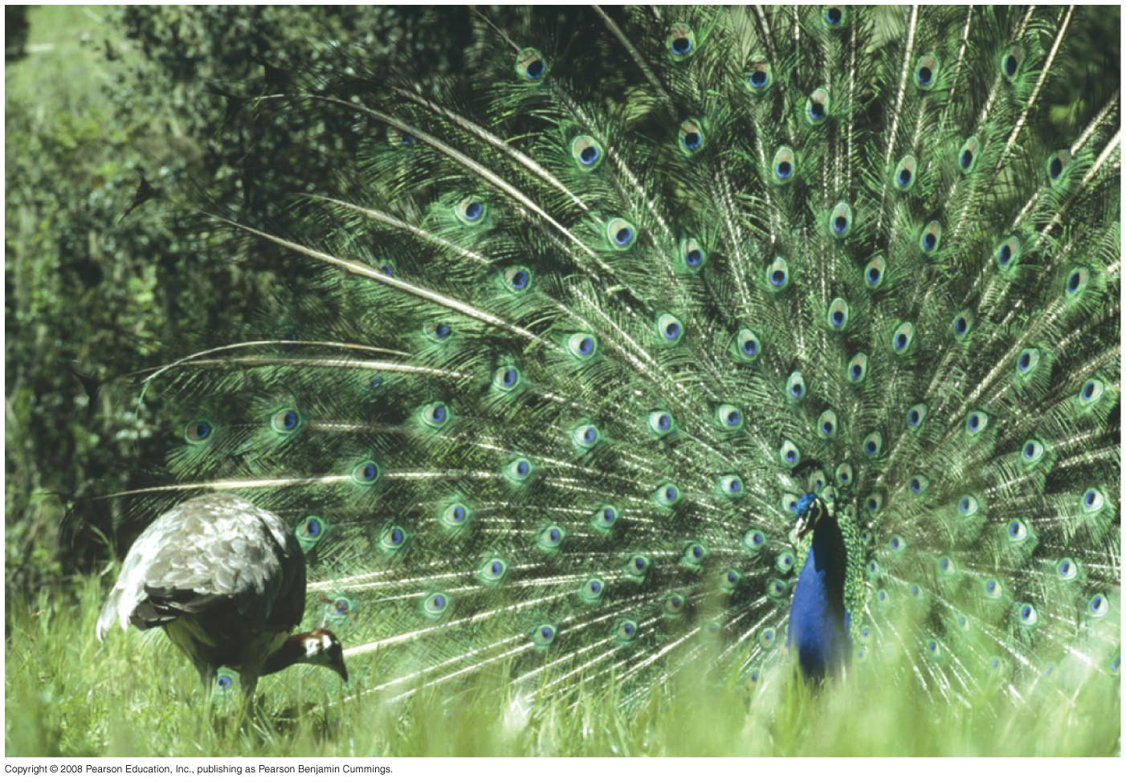
Intersexual selection (mate choice) can lead to sexual dimorphism (marked phenotypic differences between the sexes)
Some sexually dimorphic traits may actually decrease survival. Why do they persist? Why are they more common in males?

Slide 28
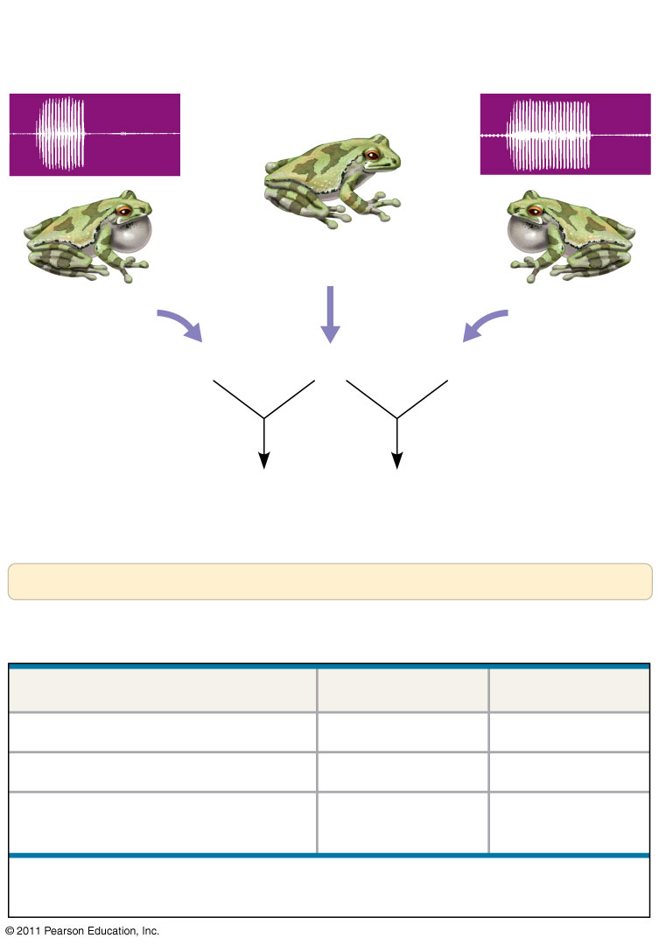
Why should a female prefer a “showier” male (i.e. why would female preference evolve) ?
One hypothesis:
Honest advertisement: male
display indicates they are high
quality mates (have “good genes”
or are better able to provide for
their mate/ offspring)
EXPERIMENT
Recording of SC
male’s call
Recording of LC
male’s call
Female gray
tree frog
SC male gray
tree frog
LC male gray
tree frog
SC sperm × Eggs × LC sperm
Offspring of Offspring of
SC father LC father
Survival and growth of these half-sibling offspring compared
RESULTS
Offspring Performance
1995
1996
Larval survival
LC better
NSD
Larval growth
NSD
LC better
Time to metamorphosis
LC better
(shorter)
LC better
(shorter)
NSD = no significant difference; LC better = offspring of LC males superior to
offspring of SC males.

Slide 29
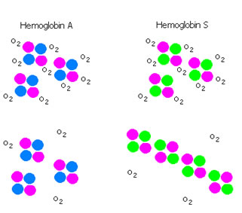
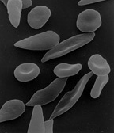
The presence of glutamate at position 6 in beta-globin causes hemoglobin to polymerize and rbcs to deform
“sickling” causes a reduction in oxygen-carrying capacity and sickled rbcs can clog capillaries
Why does the missense mutation persist?

Slide 30
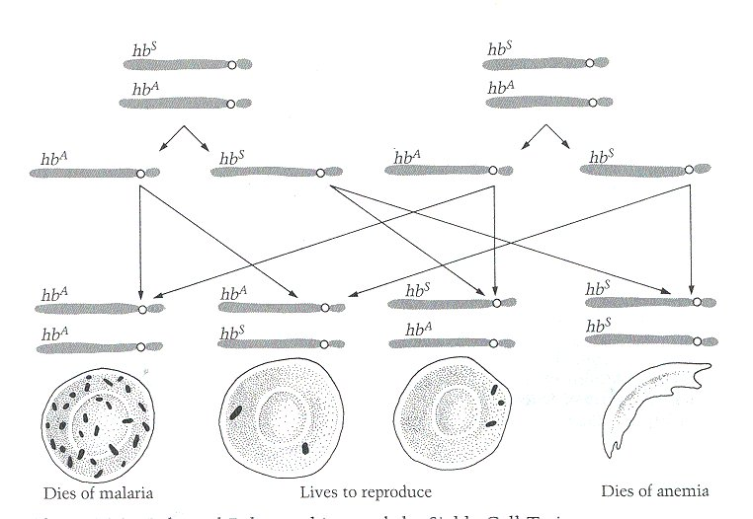
Heterozygotes exhibit resistance to infection by malaria
Malaria is transmitted by mosquitoes that carry the parasite Plasmodium falciparum

Slide 31
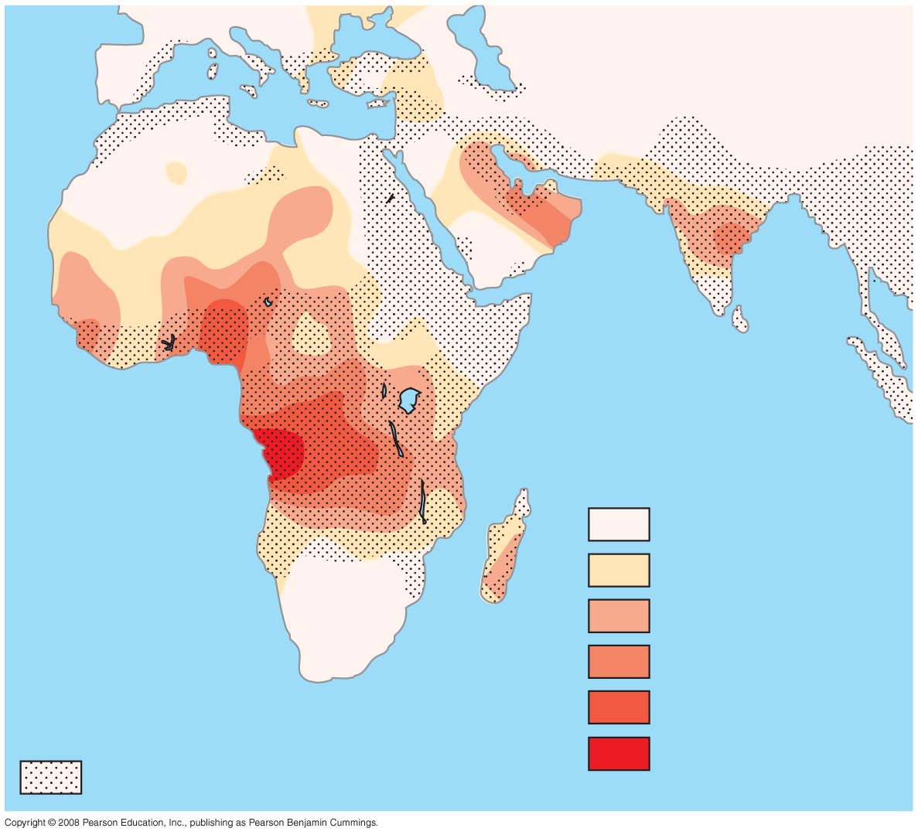
Frequencies of the
sickle-cell allele
0–2.5%
2.5–5.0%
5.0–7.5%
Distribution of
malaria caused by
Plasmodium falciparum
(a parasitic unicellular eukaryote)
7.5–10.0%
10.0–12.5%
Fig. 23-17
>12.5%

Slide 32
Natural selection cannot fashion perfect organisms
1. Evolution is limited by historical constraints
Law of Used Parts
2. Adaptations are often compromises
Newt/garter snake example
3. Not all evolution is adaptive
“the early bird isn’t always the best bird, he was just first”
Chance events affect gene pool.
4. Selection can only edit existing variations
no on-demand alleles

